Slide 1
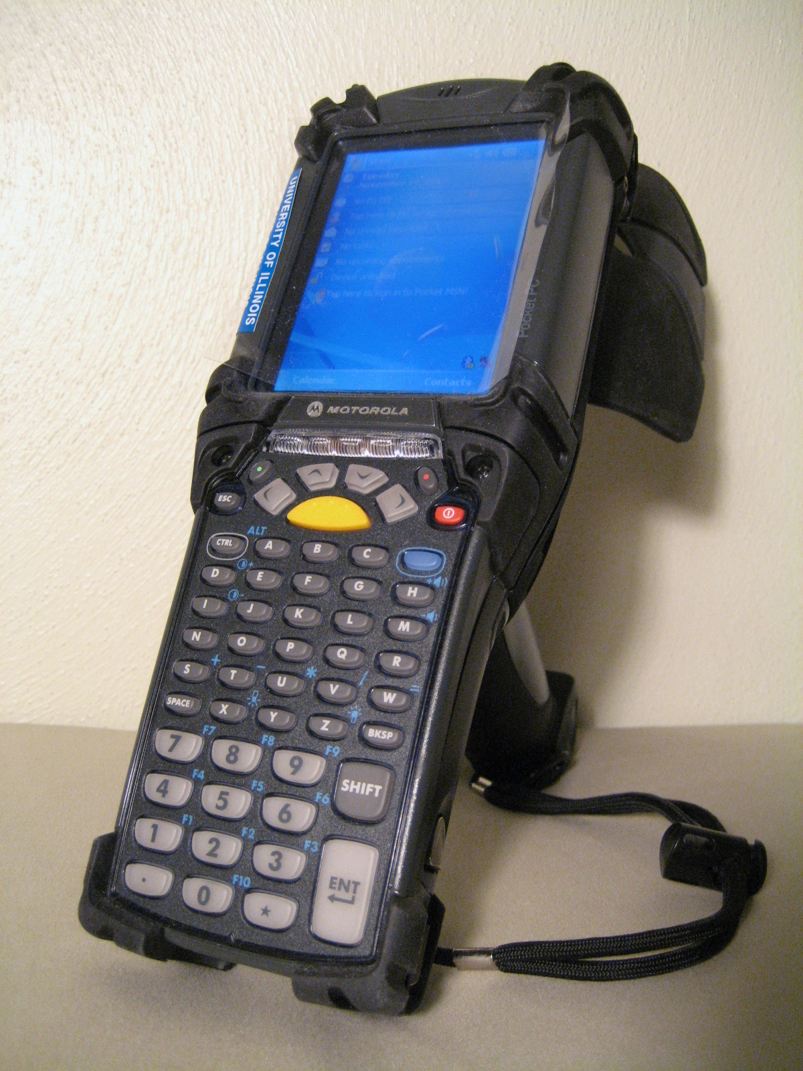
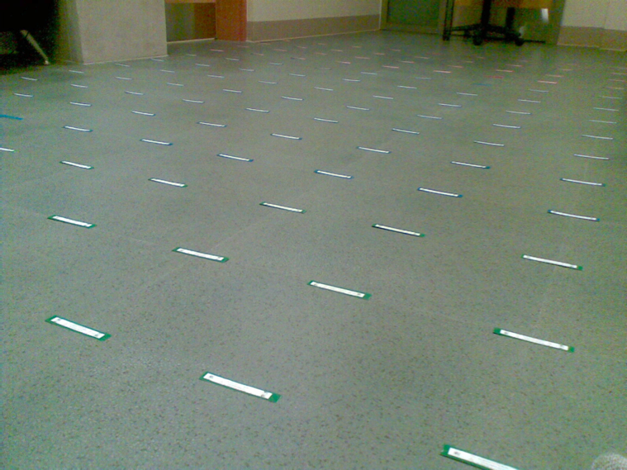
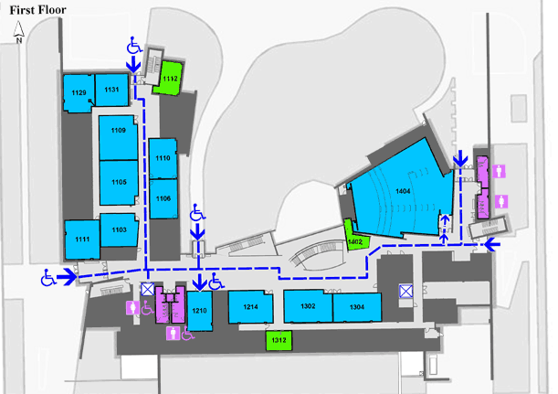

Local Real-time Neural Networks-Based Learning for Tracking in an RFID Tag Field
Victor K.Y. Wu, Nitin H. Vaidya, and Roy H. Campbell
University of Illinois at Urbana-Champaign
Passive RFID Tag Field
Stationary passive RFID tags are distributed densely over a large physical space
Tags have storage memory
Tags can fail temporarily (or scans can be inaccurate)
Tags can fail permanently due to environmental conditions such as weather
Tags are cheap, and can be replaced
System decays gracefully, according to deployment and maintenance of tags; it is robust
Users move through the tag space with RFID interrogators
Users read from and write to the tags by scanning them
A user can leave a digital trail stored in tags
A user can follow a digital trail
Multiple trails leading to a common destination is similar to a vector field
Motorola MC9090-G RFID reader.
Local Real-time Learning
Small locality of n tags
User enters locality at certain direction; exits at a difference direction
Train for correct difference exit direction, relative to entrance direction
Training based on relative scan times of tags in the locality
Many localities pointing in the correct respective directions form a digital trail
Training and testing can occur together, depending on implementation
RFID tag field.
Neural Network
Three-layer neural network
Input is relative scan times of tags
Output is difference angle
Weights stored inline in tags
Use backpropagation algorithm
A tag can belong to multiple neural networks (localities)
Siebel Center for Computer Science, University of Illinois.
References
D. Uckelmann, M. Harrison, and F. Michahelles, Architecting the Internet of Things, May 2001.
J. Bohn, “Prototypical Implementation of Location-Aware Services based on Super-Distributed RFID Tags,” in Proc. International Conference on Architecture of Computing Systems (ARCS), Frankfurt, Mar. 2006.
R.O. Duda, P.E. Hart, and D.G. Stork, Pattern Classification, 2001.

